Slide 1
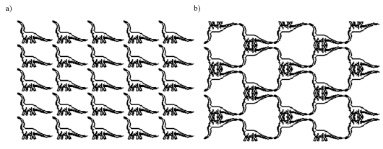
Application:Tiling with Viewports
If we lay a number of copies of a figure side by side to cover the entire screen window it’s called tiling the screen window. The picture that is copied at different positions is often called a motif. Tiling a screen window is easily achieved by using a different viewport for each instance of the motif.

Slide 2
Applications (continued)
Tiling A was set up by the following code:
  setWindow(0, 640.0, 0, 440.0); // set a fixed window
Tiling B requires more effort: you can only turn a window upside down, not a viewport.

Slide 3
Applications (continued)
Code for Tiling B
for (int i = 0; i < 5; i++) // for each column
  for (int j = 0; j < 5; j++){ // for each row
  if ((i + j) % 2 == 0){
  setWindow(0.0, 640.0, 0.0, 440.0);
  } else {
  setWindow(0.0, 640.0, 440.0, 0.0); // upside-down
  }
  glViewport (i*64, j*44,64, 44); // no distortion
  drawPolylineFile("dino.dat"); }

Slide 4
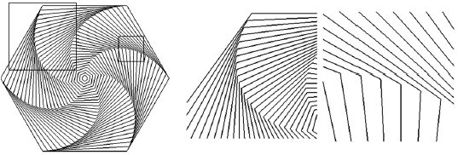
Application: Clip, Zoom and Pan
Clipping refers to viewing only the parts of an image that are in the window.

Slide 5
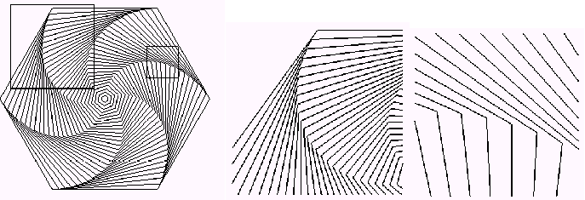
Clipping, zooming, and roaming
See the two boxes that indicate different choices of a window. Parts b and c show what is drawn if these boxes are used for the world windows. It is important to keep in mind that the same entire object is drawn in each case.
Making the window larger is similar to zooming out.
When making the window smaller, whatever is in the window must be stretched to fit in the fixed viewport, similar to zooming in.
A camera can also roam around a scene, taking in different parts of it at different times. This is easily accomplished by shifting the window to a new position.

